Slide 1
Introduction to Smart Partyware Case and Data Analysis Techniques
Workshop

Slide 2
Case #1: Direct Marketing
Applichem want to diversify and grow beyond the Release-Ease chemical market.
Applichem has an opportunity to purchase a SmartPartyWare (SPW) company, which make party ware that use Release-Ease chemicals.
Question: Does this make sense?
SPW currently has 500,000 customers in its database. Can we leverage 500,000 customers in the database?
How to do cost-benefit analysis on the existing data provided by the company?

Slide 3
Case 1 - Discussion
What is the Business Model?
Conversion Rates for
Banner Ads
SEM
Cold Call
Direct Marketing

Slide 4
Data Dictionary
Variable Name | Description
Seq# | Sequence number in the partition
ID# | Identification number in the full (partitioned) market test data set
Gender | O = Male 1 = Female
M | Monetary—total money spent on Partyware
R | Recency—months since last purchase
F | Frequency—total number of purchases
FirstPurch | Months since first purchase
Sports Party | Number of purchases from the category: Sports Party
Pool Party | Number of purchases from the category: Pool Party
Barbeque Party | Number of purchases from the category: Pool Party
Birthday Party | Number of purchases from the category: Birthday Party
End-of-School-Term Party | Number of purchases from the category: End-of-School-Year Party
Art Party | Number of purchases from the category: Art Party
Block Party | Number of purchases from the category: Block Party
Cooking Party | Number of purchases of the category: Cooking Party
Get Together | Number of purchases of the category: Get Together
Movie Night | Number of purchases of the category: Movie night
Success | =1 Celebrating American Arts was bought, = 0 if not

Slide 5
Know Thy’s - Discussion
What is SPW’s Business Model?
What is SPW’s Product?
Who are your customers?
Name three characteristics of your customer

Slide 6
Discussion
Are there any SPW’s Business Policies? Why?

Slide 7
In Real life:
Know thy Company, Industry and Competitors
Know thy Members, Customers, Prospects
Know thy Product(s)
Know thy Constraints
Know thy Objective, Strategy,…
Know thy Constraints
Know thy ……

Slide 8
Discussion – Critical Thinking
Why 2000?
Think from Data point of View
CI =?, ME =??
Training
Testing

Slide 9
Random & God Marketing
Random Marketing → 100,000 Profit?
= 100,000 * 0.112 * 45.5 + 100,000 *0.888* (-4) = $154,000
God Marketing → How many? Profit?
The Maximum profit that can be made is 56,000 * 45.5 = $2,548,000, if we mail Product only to the buyers.

Slide 10
Discussion
What is Current Business Model?
Can we Visualize the data?
What Business Insights did you get?

Slide 11
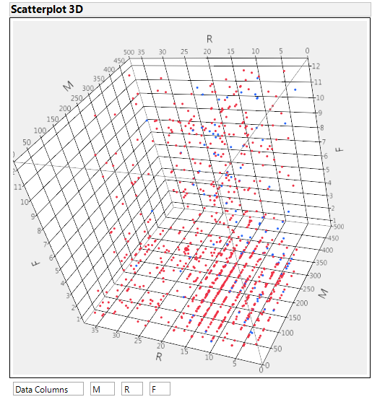
RFM Marketing Insights

Slide 12
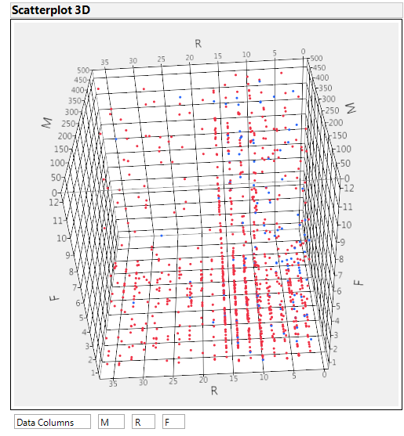
RFM Marketing Insights

Slide 13
What data is being used? Explain more
A sample Tuple from the data base.
ID# | Gender | M | R | F | FirstPurch | Sports Party | Pool Party | Barbeque Party | Birthday Party
546 | 1 | 41 | 8 | 1 | 8 | 0 | 0 | 0 | 0
End-of-School Term Party | Art Party | Block Party | Cooking Party | Get Together | Movie Night | Buy (Success)
0 | 0 | 0 | 0 | 0 | 0 | 1

Slide 14
Tuple
Tuples represent Subjects:
In this case, the subjects are SPW members: the tuples represent the 2000 members who were selected to receive the new products (American Art Themed partyware) based on some variables.
Each row is one tuple in the JMP spreadsheet for this case which contains the following demographic, psychographic, and transactional information (the variables) about each specific subject that is identified with an ID number and also identified as buyer (success =1) or non-buyer (success=0)
Variables captured in Tuples in Case1 spreadsheet:
Transactional
Monetary
Frequency
Psychological
Type of Party Themes purchased in the past
Recency
Demographic
gender
First purchase

Slide 15

Current model
Transactional
Monetary
Frequency
Psychological
Type of Party Themes purchased in the past (esp. Art Party)
Recency
Demographic
gender
First purchase
Rcency & the type of party themes purchased in the past (especially whether or not it includes an ‘art party’) are the two variables to include in the model

Slide 16
Smart Party ware - Financial Limits and Collecting Data
The Random Marketing Scenario is $154,000
The God Marketing Scenario is $2,548,000
---------------
Rule 1: If possible get fresh data – Trial Marketing data and merge it with existing database.
Remember the sample size formula
N = 1/ e^2 for 95% confidence.
Step1: Randomize the data
Step2: Divide the data set into two parts
Training Data Set
Testing Data Set
In real life – we may divide into three parts.

Slide 17
Smart Partyware Example
Let us use JMP to do Smart Partyware Problem.
How to get JMP Best Model and Interpret
Training – Statistical KPIs
Business KPIs
Testing – Statistical KPIs
Business KPIs

Slide 18
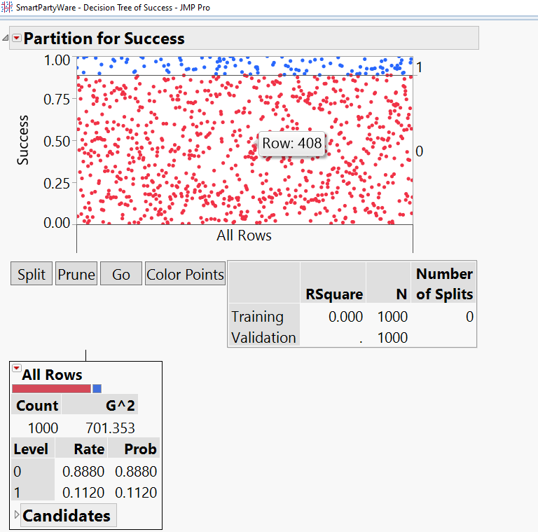
Decision Tree

Slide 19
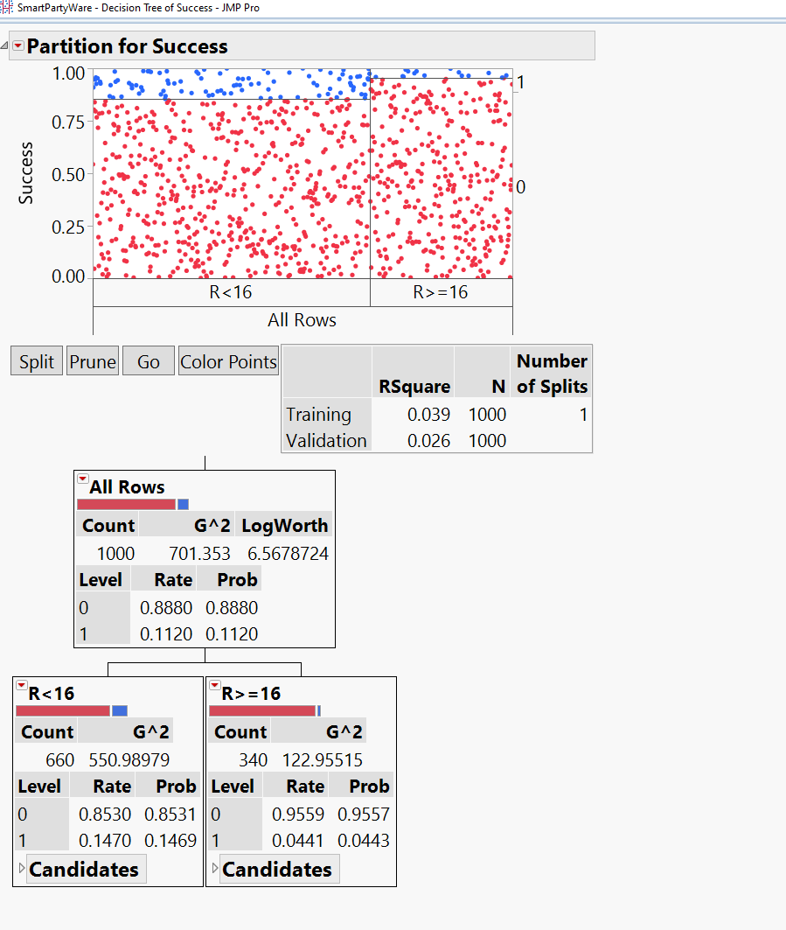

Slide 20
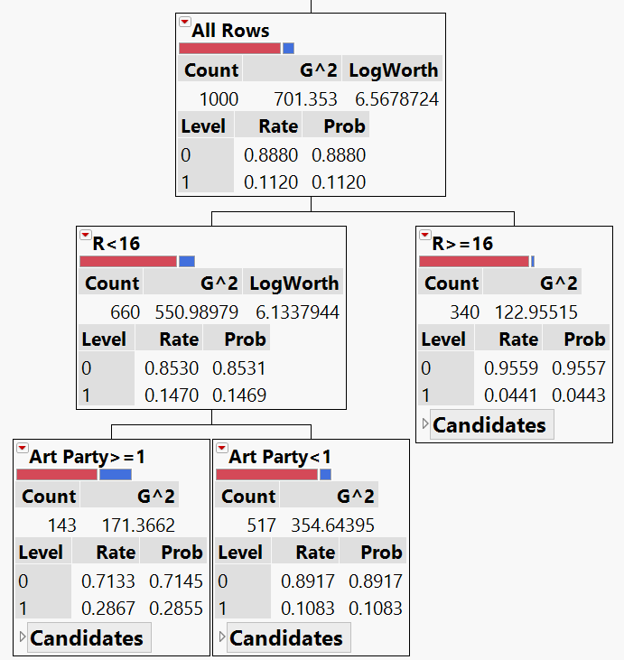

Slide 21
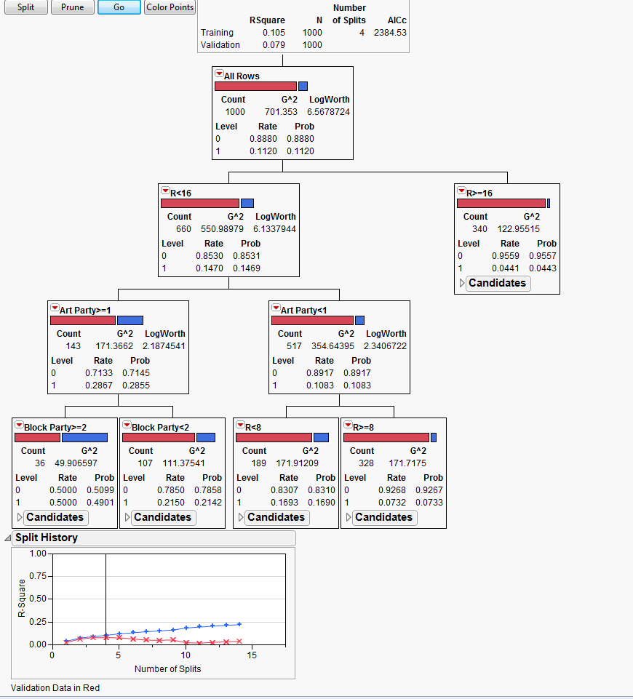

Slide 22
Leaf Report
Response Probability
Leaf Label | 0 |  | 1
R<16&Art Party>=1&Block Party>=2 | 0.5099 |  | 0.4901
R<16&Art Party>=1&Block Party<2 | 0.7858 |  | 0.2142
R<16&Art Party<1&R<8 | 0.8310 |  | 0.1690
R<16&Art Party<1&R>=8 | 0.9267 |  | 0.0733
R>=16 | 0.9557 |  | 0.0443
Response Counts
Leaf Label | 0 |  | 1
R<16&Art Party>=1&Block Party>=2 | 18 |  | 18
R<16&Art Party>=1&Block Party<2 | 84 |  | 23
R<16&Art Party<1&R<8 | 157 |  | 32
R<16&Art Party<1&R>=8 | 304 |  | 24
R>=16 | 325 |  | 15

Slide 23
If-Then-Else Rule
Leaf Label | 0 |  | 1
R<16&Art Party>=1&Block Party>=2 | 0.5099 |  | 0.4901
R<16&Art Party>=1&Block Party<2 | 0.7858 |  | 0.2142
R<16&Art Party<1&R<8 | 0.831 |  | 0.169
R<16&Art Party<1&R>=8 | 0.9267 |  | 0.0733
R>=16 | 0.9557 |  | 0.0443
In English | Not Buy |  | Buy | Your
 |  |  |  | Decision
If Recency is less than 16 months and Number of Art Party Item bought is greater than or equal to 1 and Block Party is greater than or equal 2 then the propensity to …. | 0.5099 |  | 0.4901
If Recency is less than 16 months and Number of Art Party Item bought is greater than or equal to 1 and Block Party is less than 2 then the propensity to …. | 0.7858 |  | 0.2142
If Recency is less than 16 months and Number of Art Party Item bought is less than 1 and Recency is less than 8 then the propensity to …. | 0.831 |  | 0.169
If Recency is less than 16 months and Number of Art Party Item bought is less than 1 and Recency is Greater than or equal to 8 then the propensity to …. | 0.9267 |  | 0.0733
If Recency is greater than or equal to 16 months then the propensity to … | 0.9557 |  | 0.0443

Slide 24
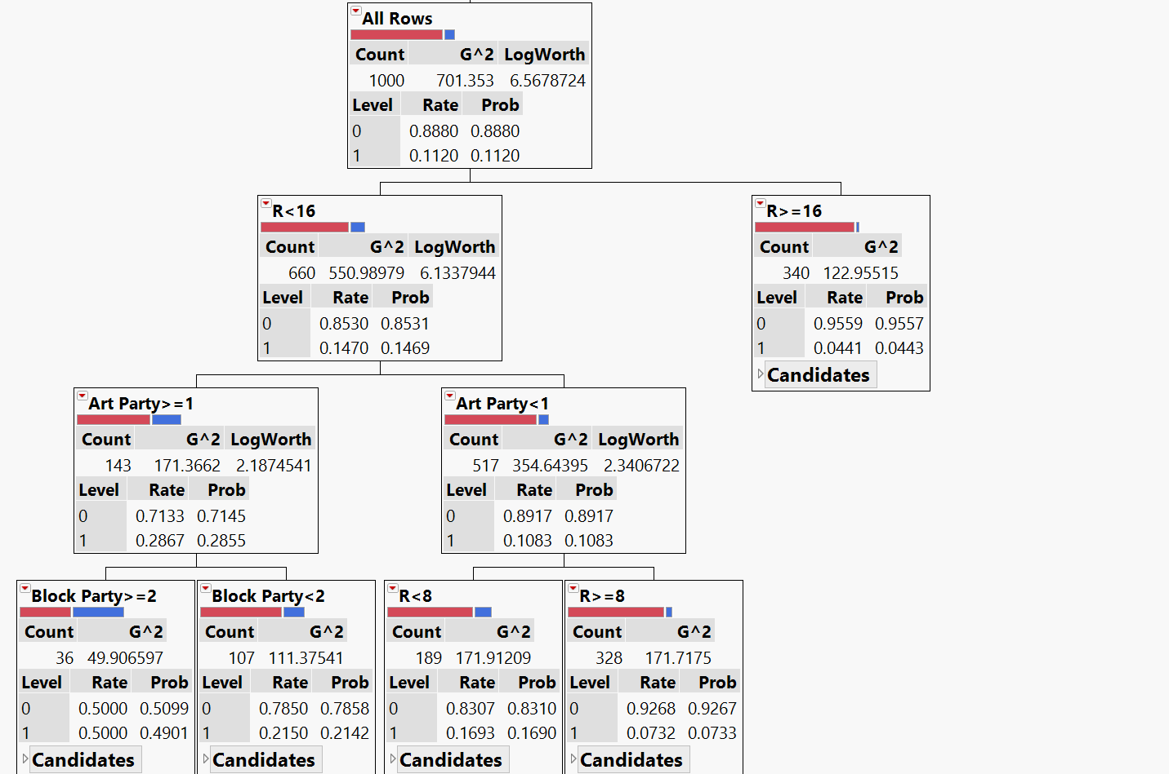
Box Selection → Cutoff is >15%

Slide 25
Business English Rule
In English | Buy |  | Not Buy | Your Decision
If Recency is greater than or equal to 16 months then the propensity to … | 0.0443 |  | 0.9557 | No
If Recency is greater than or equal to 8 but less than 16 months and Number of Art Party Item bought is zero then the propensity to …. | 0.0733 |  | 0.9267 | No
If Recency is less than 8 and Number of Art Party Item bought is zero then the propensity to …. | 0.1690 |  | 0.8310
If Recency is less than 16 months and Number of Art Party Item bought is greater than or equal to 1 and Block Party is less than 2 then the propensity to …. | 0.2142 |  | 0.7858
If Recency is less than 16 months and Number of Art Party Item bought is greater than or equal to 1 and Block Party is greater than or equal 2 then the propensity to …. | 0.4901 |  | 0.5099
Response Counts
Leaf Label | 1 | Prob1 | 0 | Total
R>=16 | 15 | 0.0443 | 325 | 340
R<16&Art Party<1&R>=8 | 24 | 0.0733 | 304 | 328
R<16&Art Party<1&R<8 | 32 | 0.1690 | 157 | 189
R<16&Art Party>=1&Block Party<2 | 23 | 0.2142 | 84 | 107
R<16&Art Party>=1&Block Party>=2 | 18 | 0.4901 | 18 | 36
0.15
0.2
0.4

Slide 26
Profit Calculator Results
Fill-in your confusion Matrix- Training
Confusion Matrix
 |  |  | Predicted
 |  | Not Buyer | Buyer
 | Not Buyer | 629 | 259 | 888
Actual | Buyer | 39 | 73 | 112
 |  | 668 | 332 | 1000
 |  | Fill in the values here |  | These are fixed
 |  |  |  | Values
Predicted number of Buyer | = | 166000
Upper limit for packages sent | = | 100000
Actual number of packages sent | = | 100000
 |  |  |  | This will be
Propensity to buy the Package | = | 21.988% |  | Automatically
Propensity to not buy the Package | = | 78.012% |  | Calculated
Total Profit | = | $ 688,404

Slide 27
Profit Calculator Results
Other Metrics
Accuracy % | 70.20%
True Positive Rate | 65.18% | True Positive/(True Positive+False Negative)
False Positive Rate | 29.17% | False Positive /(True Negative+False Positive)
Sensitivity ( True Positive Rate) | 65.18% | True Positive/(True Positive+False Negative)
Specificity (True Negative Rate) | 70.83% | True Negative /(True Negative+False Positive)
Lift Table in Dollars | Training | Testing
Lift with respect to Baseline - JMP Model | 4.458572632 | 3.939982729
Lift with respect to Baseline - My Best Model | #DIV/0! | #DIV/0!
Lift with respect to JMP Model - My Contribution | #DIV/0! | #DIV/0!
Overall Lift with respect to Baseline -My Best Model | #DIV/0! | #DIV/0!
Lift Table in Propensity | Training | Testing
Lift with respect to Baseline - JMP Model | 1.963209983 | 1.818783069
Lift with respect to Baseline - My Best Model | #DIV/0! | #DIV/0!

Slide 28
Profit Calculator Results
Fill-in your confusion Matrix - Testing
Confusion Matrix
 |  |  | Predicted
 |  | Not Buyer | Buyer
 | Not Buyer | 637 | 258 | 895
Actual | Buyer | 39 | 66 | 105
 |  | 676 | 324 | 1000
Predicted number of Buyer | = | 162000
Upper limit for packages sent | = | 100000
Actual number of packages sent | = | 100000
 |  |  | Note the number of Packages mailed
Propensity to buy the Package | = | 20.370%
Propensity tonot buy the Package | = | 79.630%
Total Profit | = | $ 608,333

Slide 29
Three different Approaches to Build better Models
1) Use JMP Best Model and to do further splits, What logic to use??

Slide 30
Three different Approaches to Build better Models
2) Use JMP Best Model Approach but use Business Values and do further splits, What logic to use??

Slide 31
Three different Approaches to Build better Models
3) Use Domain Expertise – Very hard without insights.

Slide 32
Approaches to Build better Models
Learn which variables are important
Try to create variables that make business sense and leverage domain expertise
Transform, Enrich, Interaction variables – Use statistical knowledge

